Slide 1
301 Oct 15, Class 13
Baddley & Hitch (2017)
  Designing Experiment 2
  Examples of factorial design and analysis

Slide 2
Choosing where to sit
In a study of interpersonal closeness, researchers primed either independence or interdependence by writing out reasons why they thought of themselves as similar or different from their close friends and family.
Participants were then were asked to take a seat in a waiting area full of chairs where a jacket indicated the presence of another person.
Data from men and women in the study were considered separately
The dependent variable measured was the number of chairs between the jacket and the chosen seat.

Slide 3
 | Men | Women
Independent
Interdepdendent
6.1
4.5
4.3
2.7

Slide 4

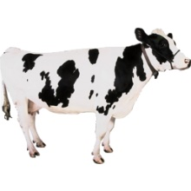



Slide 5
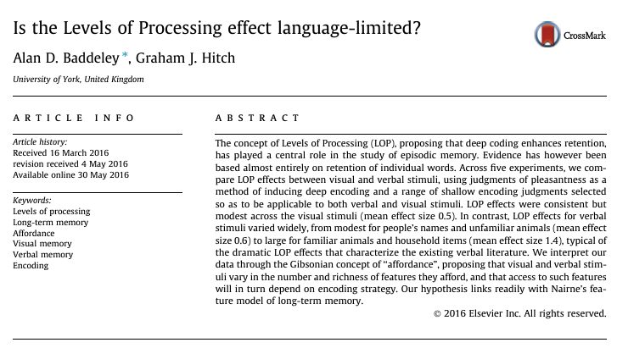

Slide 6
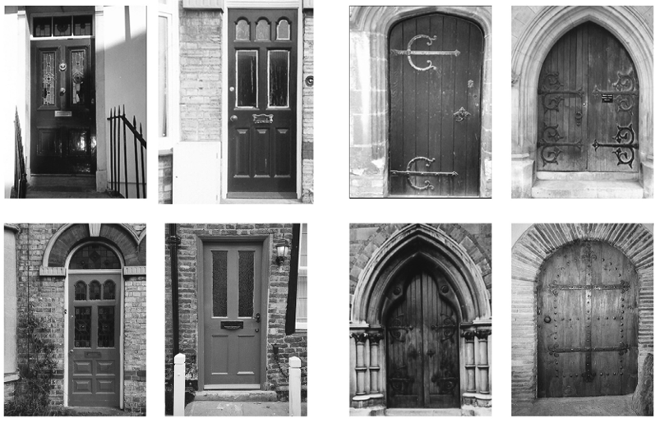

Slide 7
In Experiment 1, what were the 2 factors and levels of each in the experimental design?
Why did these studies not use an incidental learning paradigm as the prior work (and ours) did? (see the General discussion)

Slide 8
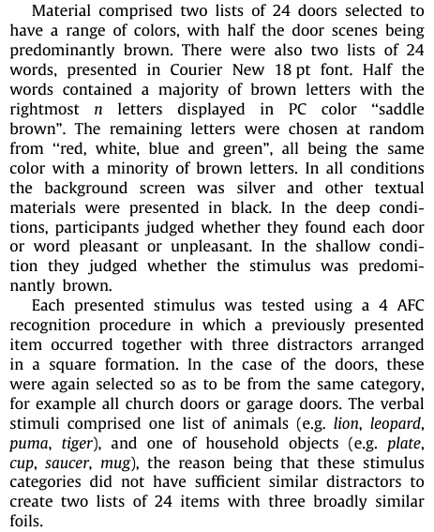
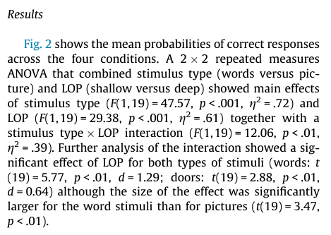

Slide 9
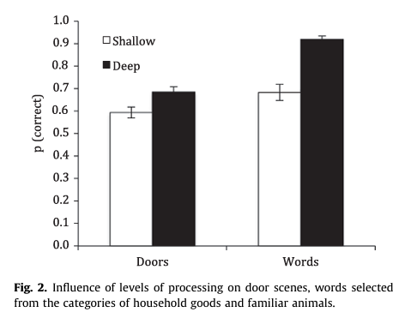

Slide 10
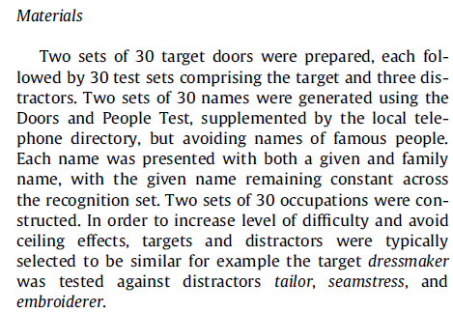
In Experiment 2, what were the factors and how many levels of each factor were used in the experimental design?

Slide 11
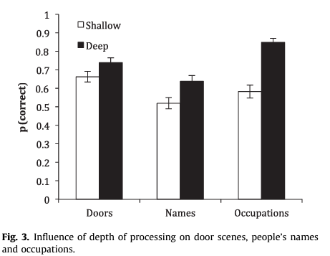
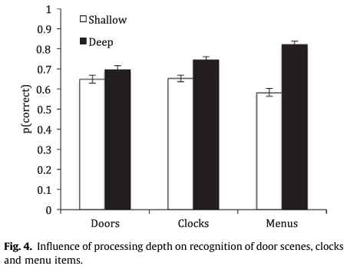
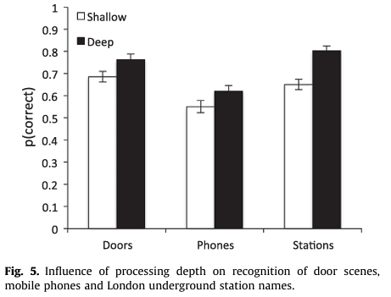
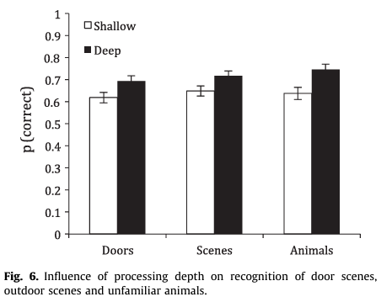

Slide 12
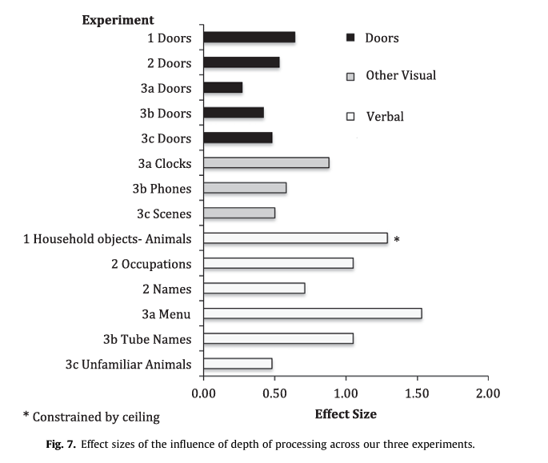
Using effect size estimates to view data across different studies
  Meta-analysis
Cohen’s d effect sizes

Slide 13
What did the authors conclude about the effect of “deep” encoding on visual non-verbal stimuli?

Slide 14
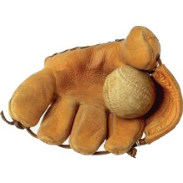
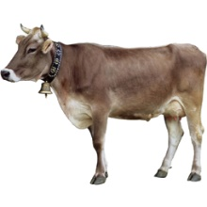

Slide 15
Operational definitions
Deep?
Shallow?

Slide 16
Factorial diagram
 |  | Type of Picture
 |  | Meaningful | Abstract
Type of Study | Deep
 | Shallow

Slide 17
For Fri 10/17
Read Levav & Argo (2010)
  Factorial design example
Read Ovalle-Fresa, Uslu & Rothen (2021)
  More background for Experiment 2
Answer questions about each report on Canvas
Data collection for Experiment 2 will become available tonight or tomorrow and run through Monday Oct 20
  Try to get 4 friends or family to run through the study for us
  Upload their completion codes if they remember to send them to you

